Slide 1
Cascading Style Sheet

Slide 2
Cascading Style Sheet
CSS describes how HTML elements are to be displayed on screen, paper, or in other media
CSS saves a lot of work. It can control the layout of multiple web pages all at once
HTML was created to describe the content of a web page, like: <h1>This is a heading</h1>, <p>This is a paragraph.</p>
When tags like <font>, and color attributes were added to the HTML 3.2 specification, it started a nightmare for web developers.
To solve this problem, the World Wide Web Consortium (W3C) created CSS.
CSS removed the style formatting from the HTML page!

Slide 3
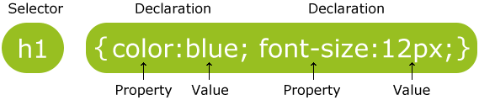
CSS Syntax
A CSS rule-set consists of a selector and a declaration block:
The selector points to the HTML element you want to style.
The declaration block contains one or more declarations separated by semicolons.
Each declaration includes a CSS property name and a value, separated by a colon.
A CSS declaration always ends with a semicolon, and declaration blocks are surrounded by curly braces.

Slide 4
CSS Selectors
CSS selectors are used to "find" (or select) HTML elements based on their element name, id, class, attribute, and more.
You can select all <p> elements on a page like this
p { text-align: center; color: red; }
The id selector uses the id attribute of an HTML element to select a specific element. To select an element with a specific id, write a hash (#) character, followed by the id of the element.
#para1 { text-align: center; color: red; }
Implemented as <p id="para1">Hello World!</p>

Slide 5
CSS Selectors
The class selector selects elements with a specific class attribute. To select elements with a specific class, write a period (.) character, followed by the name of the class
.center { text-align: center; color: red; }
Implemented as <h1 class="center">Red and center-aligned heading</h1>

Slide 6
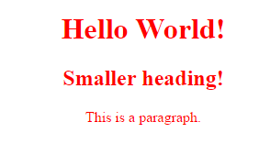
Example CSS
<!DOCTYPE html>
<html>
<head>
<style>
h1, h2, p {
text-align: center;
color: red;
}
</style>
</head>
<body>
<h1>Hello World!</h1>
<h2>Smaller heading!</h2>
<p>This is a paragraph.</p>
</body>
</html>

Slide 7
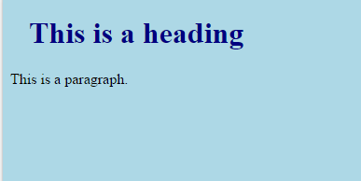
Three Ways to Insert CSS
There are three ways of inserting a style sheet:
External style sheet
Internal style sheet
Inline style
External Style Sheet
<head> <link rel="stylesheet" type="text/css" href="mystyle.css"> </head>
"myStyle.css" looks:
body { background-color: lightblue; } h1 { color: navy; margin-left: 20px; }

Slide 8
Insert CSS
Internal Style Sheet
<head> <style> body { background-color: linen; } h1 { color: maroon; margin-left: 40px; } </style> </head>

Slide 9
Insert CSS
Inline Styles
<h1 style="color:blue;margin-left:30px;">This is a heading.</h1>

Slide 10
Colors
colors in CSS are most often specified by:
a valid color name - like "red"
an RGB value - like "rgb(255, 0, 0)"
a HEX value - like "#ff0000"
Color | Name
 | Red
 | Green
 | Blue
 | Orange
 | Yellow
 | Cyan
 | Black

Slide 11
Colors
Color | RGB
 | rgb(255,0,0)
 | rgb(0,255,0)
 | rgb(0,0,255)
 | rgb(255,165,0)
 | rgb(255,255,0)
 | rgb(0,255,255)
Color | RGB
 | rgb(0,0,0)
 | rgb(128,128,128)
 | rgb(255,255,255)

Slide 12
Colors
Color | HEX
 | #FF0000
 | #00FF00
 | #0000FF
 | #FFA500
 | #FFFF00
 | #00FFFF

Slide 13
Colors
<h2 style="background-color:red"> Red background-color </h2>
<h2 style="background-color:rgb(255, 0, 0)">rgb(255, 0, 0) </h2>
<h2 style="background-color:#FF0000"> #FF0000 </h2>
Output:

Slide 14
CSS Box model
The CSS border properties allow you to specify the style, width, and colour of an element's border.
The CSS margin properties are used to generate space around elements. The margin properties set the size of the white space outside the border. CSS has properties for specifying the margin for each side of an element: margin-top, margin-right, margin-bottom, margin-left
All the margin properties can have the following values:
auto - the browser calculates the margin
length - specifies a margin in px, pt, cm, etc.
% - specifies a margin in % of the width of the containing element
inherit - specifies that the margin should be inherited from the parent element

Slide 15
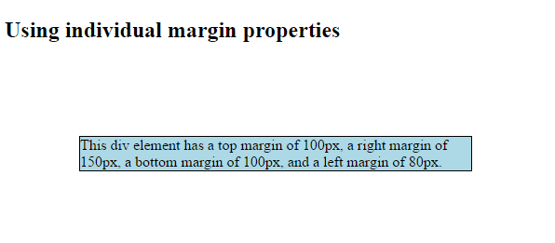
CSS Box model
div {
border: 1px solid black;
margin-top: 100px;
margin-bottom: 100px;
margin-right: 150px;
margin-left: 80px;
background-color: lightblue;
}

Slide 16
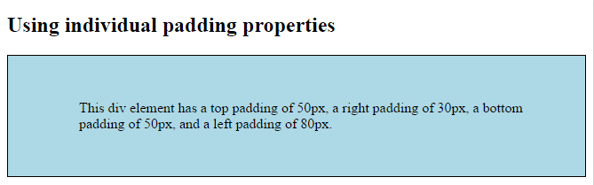
CSS Box model
The CSS padding properties are used to generate space around content.
div {
border: 1px solid black;
background-color: lightblue;
padding-top: 50px;
padding-right: 30px;
padding-bottom: 50px;
padding-left: 80px;
}

Slide 17
CSS Box model
The height and width properties are used to set the height and width of an element.
The Max-Height and Max-width properties override the height and width properties.

Slide 18

CSS Box model
The CSS box model is essentially a box that wraps around every HTML element. It consists of: margins, borders, padding, and the actual content. The image below illustrates the box model:

Slide 19
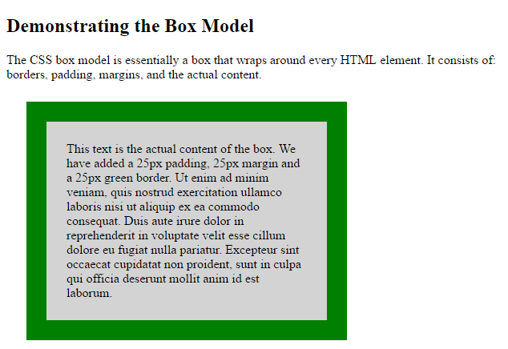
CSS Box model
div {
background-color: lightgrey;
width: 300px;
border: 25px solid green;
padding: 25px;
margin: 25px;
}

Slide 20
CSS Custom font
@font-face is a css rule which allows you to download a particular font from your server to render a webpage if the user hasn't got that font installed.
This means that web designers will no longer have to adhere to a particular set of "web safe" fonts that the user has pre-installed on their computer.
Syntax
@font-face { font-properties }

Slide 21
Font Properties
Font descriptor | Values | Description
font-family | name | Required. Defines the name of the font.
src | URL | Required. Defines the URL(s) where the font should be downloaded from
font-stretch | normal condensed expanded | Optional. Defines how the font should be stretched. Default value is "normal"
font-style | normal italic oblique | Optional. Defines how the font should be styled. Default value is "normal"
font-weight | normal bold 100 200 | Optional. Defines the boldness of the font. Default value is "normal"
unicode-range | unicode-range | Optional. Defines the range of unicode characters the font supports. Default value is "U+0-10FFFF"

Slide 22
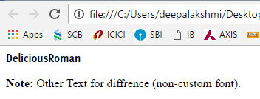
Example
@font-face {
font-family: DeliciousRoman;
src: url('Delicious-Bold.otf');
font-weight:400;
}
div {
font-family: DeliciousRoman;
}

Slide 23
CSS Pseudo-elements
A CSS pseudo-element is used to style specified parts of an element.
For example, it can be used to:
Style the first letter, or line, of an element
Insert content before, or after, the content of an element
Syntax
selector::pseudo-element { property:value; }

Slide 24
CSS Pseudo Elements
Selector | Example | Example description
::after | p::after | Insert something after the content of each <p> element
::before | p::before | Insert something before the content of each <p> element
::first-letter | p::first-letter | Selects the first letter of each <p> element
::first-line | p::first-line | Selects the first line of each <p> element
::selection | p::selection | Selects the portion of an element that is selected by a user

Slide 25
Example program
p::before {
content: " Before Para..! ";
}
#id1::after {
content: " After Para ..! ";
color:red;
/*background-color, border-color, border-style*/
}
</style>
</head>
<body>
<p id="id1">First line of the paragraph <br>Second line ... <br> Third line...!</p>
<p >First line of the paragraph <br>Second line ... <br> Third line...!</p>
</body>
</html>
<style>
p::first-line {
color: Green;
font-variant: small-caps ;
}
p::first-letter {
color: Red;
font-size: 150%;
}
::selection {
color: blue;
background: yellow;
}

Slide 26
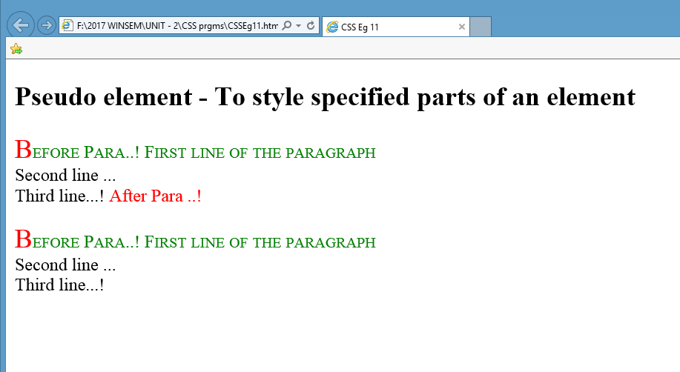
Output

Slide 27
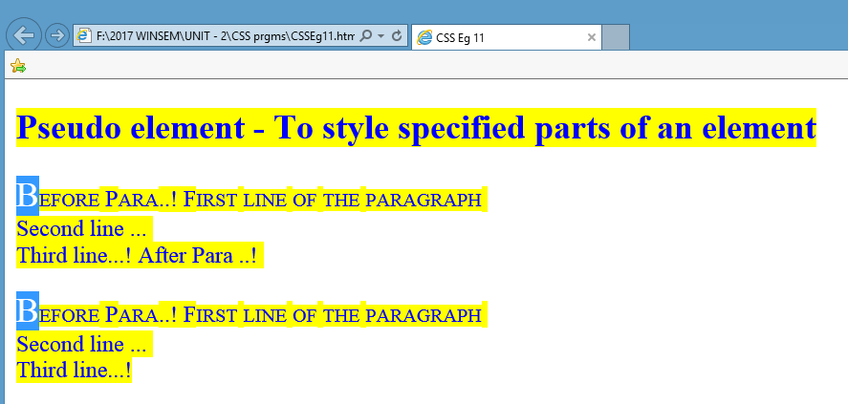
Output With selection

Slide 28
CSS Pseudo Classes
Selector | Example | Example description
:active | a:active | Selects the active link
:checked | input:checked | Selects every checked <input> element
:disabled | input:disabled | Selects every disabled <input> element
:enabled | input:enabled | Selects every enabled <input> element
:focus | input:focus | Selects the <input> element that has focus
:invalid | input:invalid | Selects all <input> elements with an invalid value
:required | input:required | Selects <input> elements with a "required" attribute specified
:valid | input:valid | Selects all <input> elements with a valid value
:visited | a:visited | Selects all visited links

Slide 29
<style>
/*a:active, a:hover, a:visited */
a:link { color: blue; }
#id1:active { color: purple; }
input:focus { background-color: green; }
#subid
{
color:red;
font-size:60%;
background-color:pink;
}
</style>
</head>
<body>
<p id="id1">First line of the paragraph <br>Second line ... <br> Third line with a link <a href="https:/google.co.in">Google</a>...!</p>
<p>First line of the paragraph <br>Second line ... <br> Third line...!</p>
<form>
Reg no:<br>
<input type="text" name="regno"><br>
School:<br>
<input type="text" name="school"><br>
<input id="subid" type="submit" value="Submit">
</form>
</body>
</html>

Slide 30
CSS:Valid Invalid Selector
<style>
input:valid {
background-color: yellow;
}
input:invalid {
border: 2px solid red;
}
input {
width: 100px;
}
input:focus {
width: 250px;
}
</style>
</head>
<body>
<h3>A demonstration of the :valid selector.</h3>
<input type="email" value="support@exampel.com">
<p>Try typing an illegal e-mail address, to see the styling disappear.</p>
</body>

Slide 31
